Slide 1

CHRONIC ABSENTEEISM RATES IN TENNESSEE SCHOOL DISTRICTS

Slide 2

Chronic absenteeism is defined as a student who is absent for 10 percent or more of the instructional days for which he or she is enrolled in a Tennessee public school or district.

Slide 3
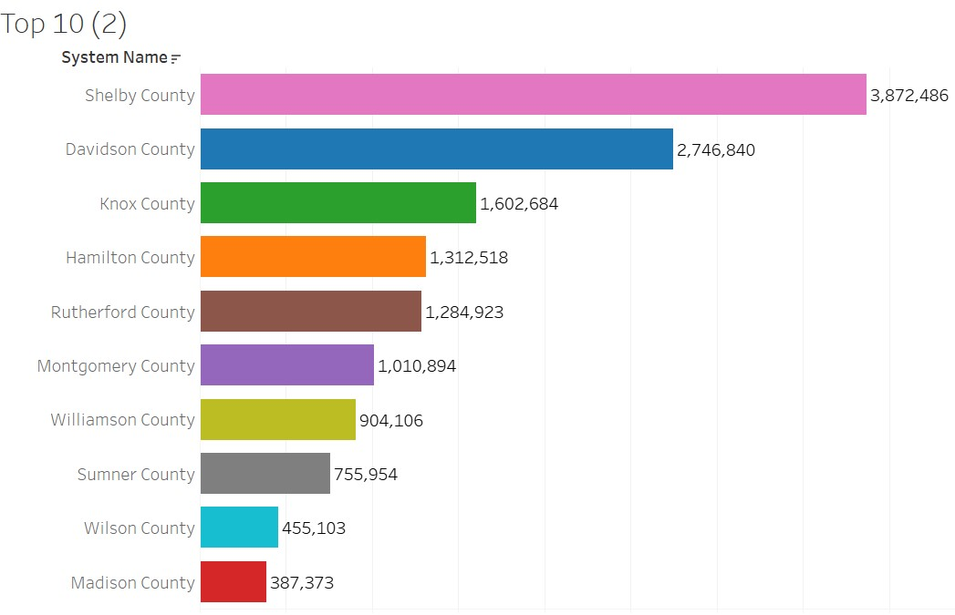
TOP 10 DISTRICTS WITH THE LARGEST STUDENT POPULATION

Slide 4
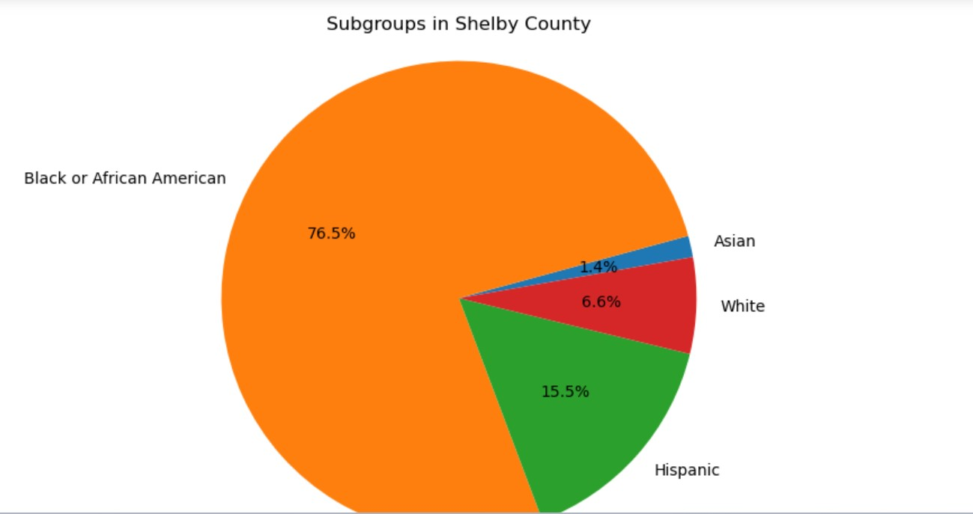

Slide 5
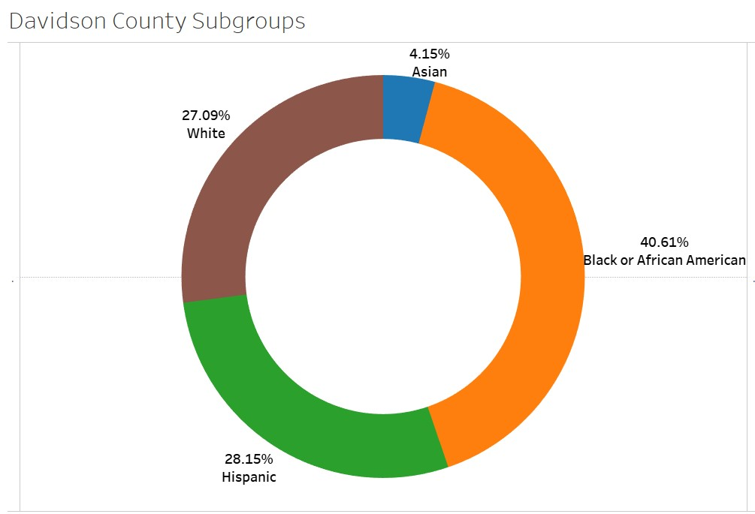

Slide 6
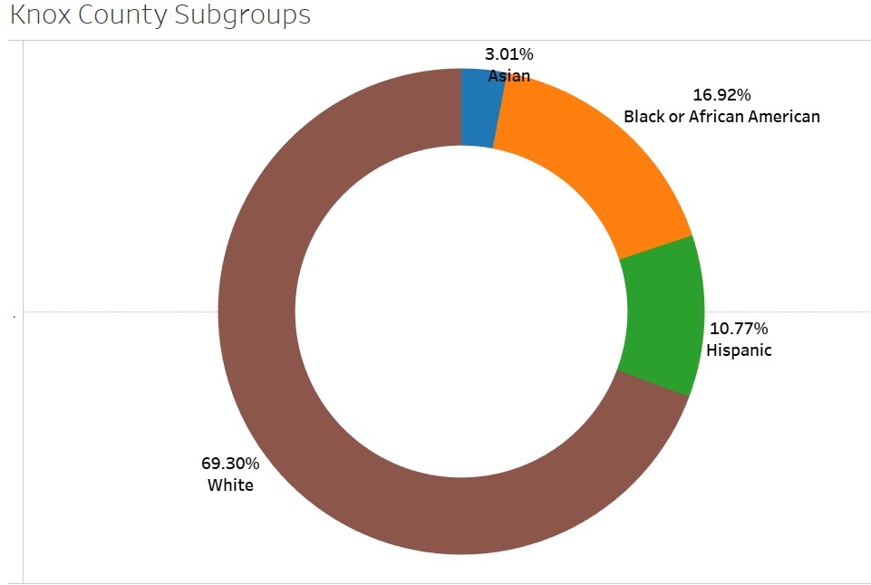

Slide 7
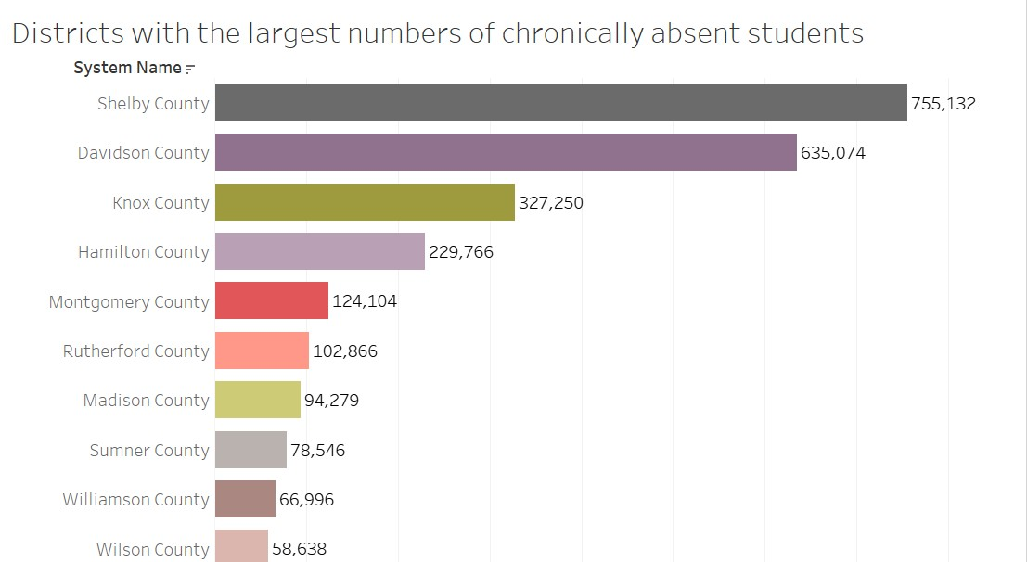

Slide 8
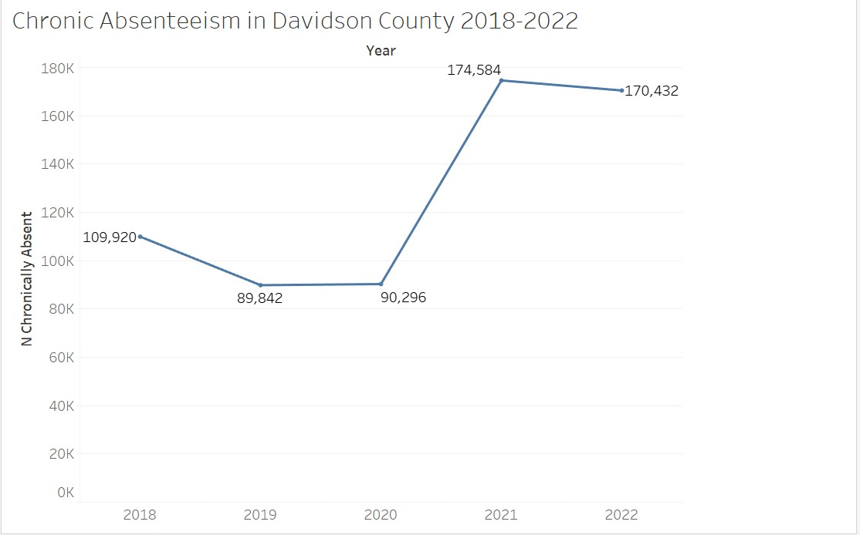

Slide 9
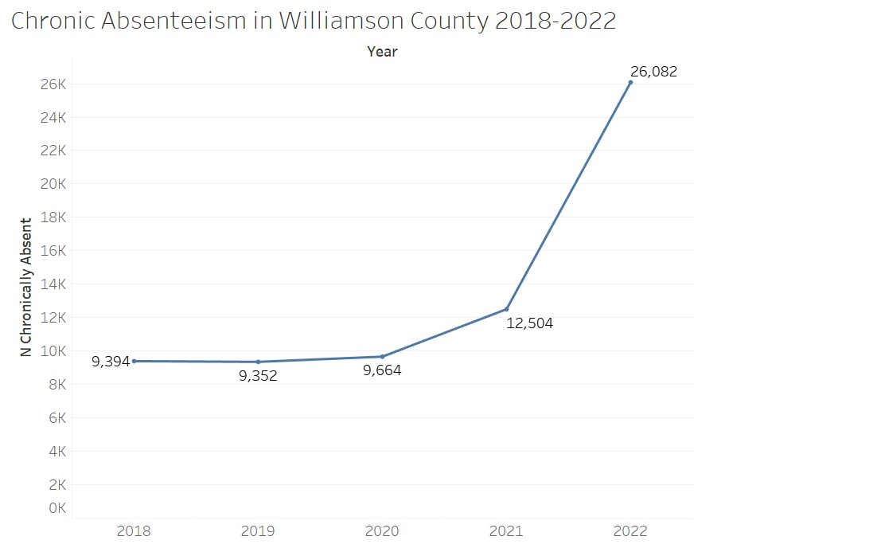

Slide 10
